Slide 1
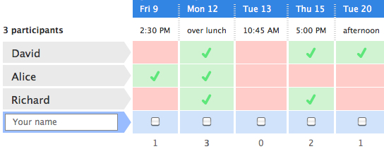
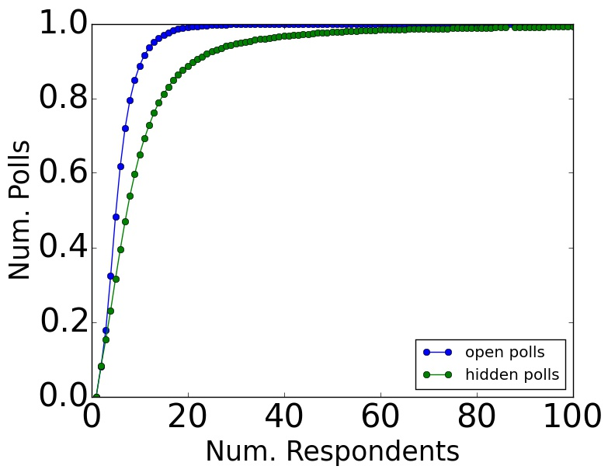
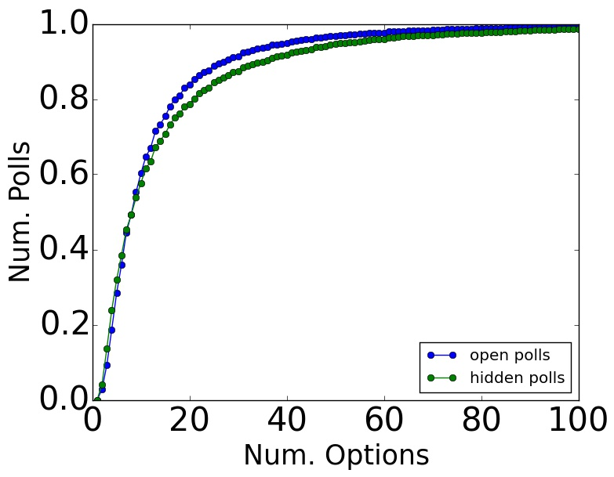
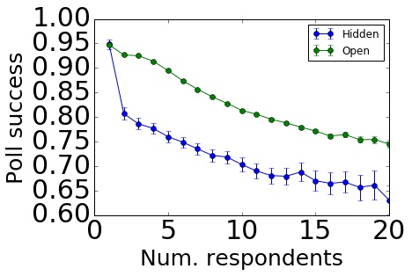
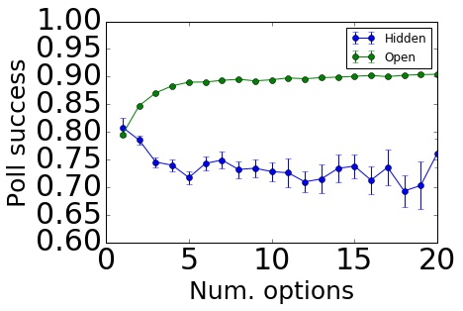
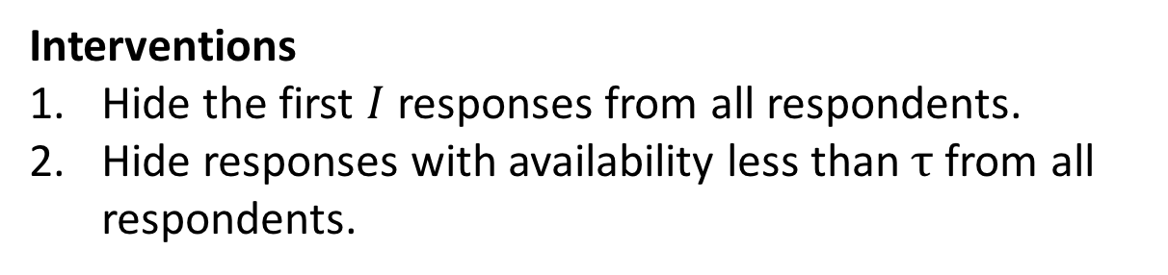

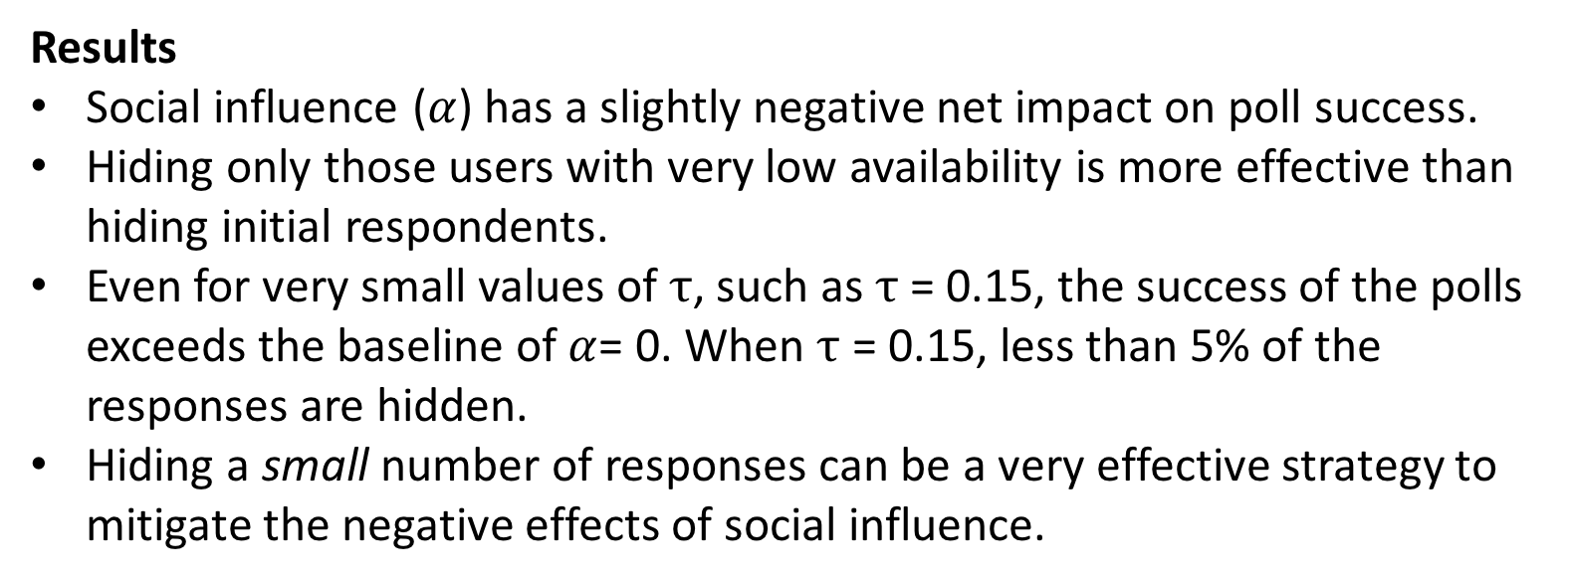
The Influence of Early Respondents: Information Cascade Effects in Online Event Scheduling
Daniel M. Romero | Katharina Reinecke | Lionel Robert
drom@umich.edu | reinecke@cs.washington.edu | lprobert@umich.edu
University of Michigan | University of Washington | University of Michigan
Highlights
Impact of Early Respondents
Sequential group decision-making processes, such as online event scheduling, can be subject to social influence and information cascades.
We investigate information cascade effects in Doodle, where later respondents adopt the decisions of earlier respondents.
We propose an event scheduling model and use it to compare possible interventions to mitigate the negative effects of information cascades.
We show that we can optimize the success of polls by hiding the responses of a small percentage of respondents with low availability.
Does the availability of early respondents disproportionally impact the success of a poll?
We measure the extent to which early respondents of a poll reported low or high availability in three ways:
Location of the respondent with lowest availability.
Location of the respondent with highest availability.
Rank correlation of sequence of availabilities and a monotonically decreasing sequence.
Results
In open polls, poll success decreases when
  response with lowest availability comes early,
  response with highest availability comes late, and
  the sequence of availability decreases monotonically.
These trends largely disappear in the control group (hidden polls).
Cascading effects appear to be present in event scheduling.
Independent Variable | Coeff. (Open) | Coeff. (Hidden)
Num. Respondents | -0.0112*** | -0.0017
Num. Options | 0.0001*** | ns
Loc. least available respondent | 0.0091*** | ns
Loc. most available respondent | -0.0039*** | -0.0008*
Increasing availability trend | -0.0156 *** | -0.0260***
Doodle Data
Doodle: A scheduling service that allows groups of people to find a mutually agreeable time to meet.
Data: 1,303,941 open and 26,613 hidden polls from 190 different countries.
Regression results. Dependent variable: poll success
Modeling Event Scheduling
Number of respondents and time options in our data ranges from 2 to over 100.
Model description
Fix the number of respondents $r$, number of slots $s$, and parameters $α∈\left[0,1\right]$ and positive integer $k$.
Respondents arrive sequentially and declare their binary availability for each slot.
Respondent $i$ reports $s$ as available with probability $p_{s,k}^{i}={\left(α\right)prev}_{k}^{i}+\left(1−α\right){pref}_{s}^{i}$.
${pref}_{s}^{i}∈\left[0,1\right]$ is the personal preference of respondent $i$ for slot $s$.
${prev}_{k}^{i}$ is the average fraction of slots that the previous k respondents marked as available.
Interventions
Hide the first $I$ responses from all respondents.
Hide responses with availability less than $τ$ from all respondents.
Poll Success
Poll success: The percentage of participants who are available on the most popular time slot.
Open polls: Respondents can see other’s responses before declaring their availability.
Hidden polls (control group): Respondents cannot see each other’s responses.
Results
Social influence ($α$) has a slightly negative net impact on poll success.
Hiding only those users with very low availability is more effective than hiding initial respondents.
Even for very small values of $τ$, such as $τ$ = 0.15, the success of the polls exceeds the baseline of$α$= 0. When $τ$ = 0.15, less than 5% of the responses are hidden.
Hiding a small number of responses can be a very effective strategy to mitigate the negative effects of social influence.
50,000 simulations with 10 respondents and 10 options.

