Slide 1

The Influence of Early Respondents: Information Cascade Effects in Online Event Scheduling
Daniel M. Romero
School of Information
University of Michigan
In collaboration with
Katharina Reinecke and Lionel P. Robert Jr.

Slide 2
Impact of Early Respondents in
Event Scheduling
 | Slot 1 | Slot 2 | Slot 3 | Slot 4 | Slot 5 | Slot 6 | Slot 7
Bob | No | No | No | Yes | No | No | No
Alice | ? | ? | ? | ? | ? | ? | ?
How will Bob’s limited availability impact others’ responses?
Competing Hypotheses:
Respondents will try to adjust their calendars to match Bob’s, making the poll more successful.
Bob’s low availability will give an excuse for other to also report low availability, making the poll less successful.

Slide 3

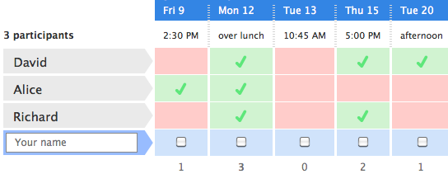

Doodle Data
Doodle: A scheduling service that allows groups of people to find a mutually agreeable time to meet.
Data: 1.3 million polls from 190 different countries.

Slide 4
Impact of Early Respondents
Does the availability of early respondents disproportionally impact the success of a poll?
Poll success: The percentage of participants who are available on the most popular time slot.
We measure the extent to which early respondents of a poll reported low or high availability in three ways:
Location of the respondent with lowest availability.
Location of the respondent with highest availability.
Rank correlation of sequence of availabilities and a monotonically decreasing sequence.

Slide 5
Impact of Early Respondents
Poll Success
Loc. lowest avail
Loc. highest avail
Corr. with desc. order
Poll success decreases when
  response with lowest availability comes early,
  response with highest availability comes late, and
  the sequence of availability decreases monotonically.
Cascading effects appear to be present in event scheduling.

Slide 6
Hidden Polls
Poll Success
Loc. lowest avail
Loc. highest avail
Corr. with desc. order
Trends largely disappear in the hidden polls.
Effects depend on users being able to observe others’ responses.

Slide 7
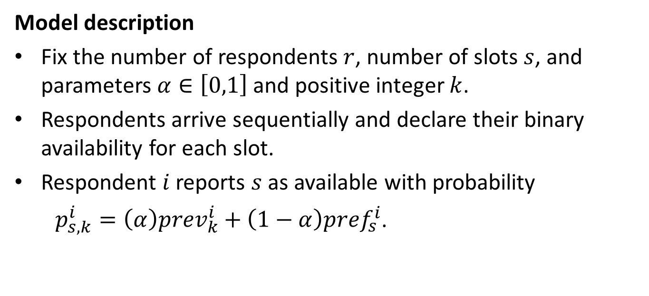
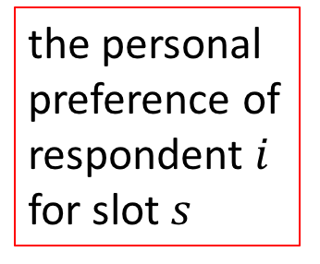
Event Scheduling Model
Model description
Fix the number of respondents $r$, number of slots $s$, and parameters $α∈\left[0,1\right]$ and positive integer $k$.
Respondents arrive sequentially and declare their binary availability for each slot.
Respondent $i$ reports $s$ as available with probability
$p_{s,k}^{i}={\left(α\right)prev}_{k}^{i}+\left(1−α\right){pref}_{s}^{i}$.
average availability of previous k respondents
the personal preference of respondent $i$ for slot $s$

Slide 8
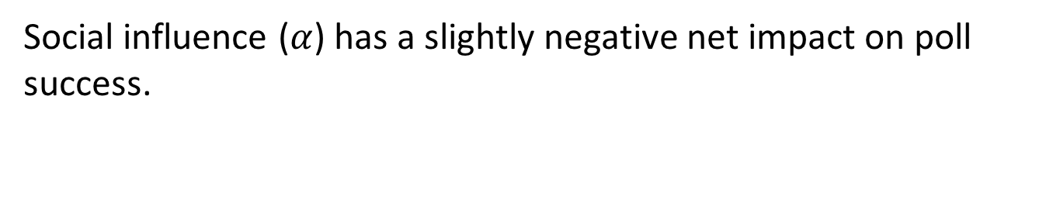

Effect of Social Influence on
Poll Success
Poll Success
social influence ($α$)
Social influence ($α$) has a slightly negative net impact on poll success.

Slide 9
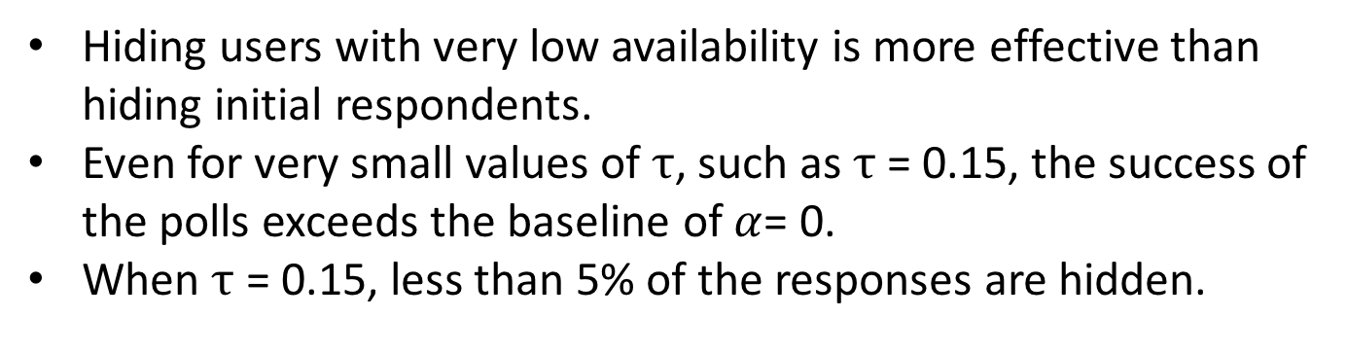


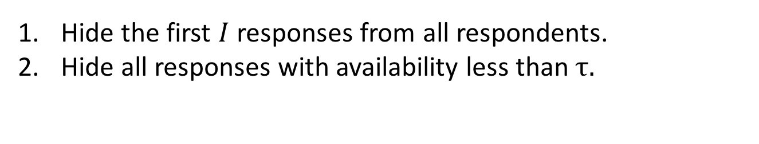
Interventions
Hide the first $I$ responses from all respondents.
Hide all responses with availability less than $τ.$
Poll Success
Poll Success
$$I$$
$$τ$$
Hiding users with very low availability is more effective than hiding initial respondents.
Even for very small values of $τ$, such as $τ$ = 0.15, the success of the polls exceeds the baseline of$α$= 0.
When $τ$ = 0.15, less than 5% of the responses are hidden.

Slide 10
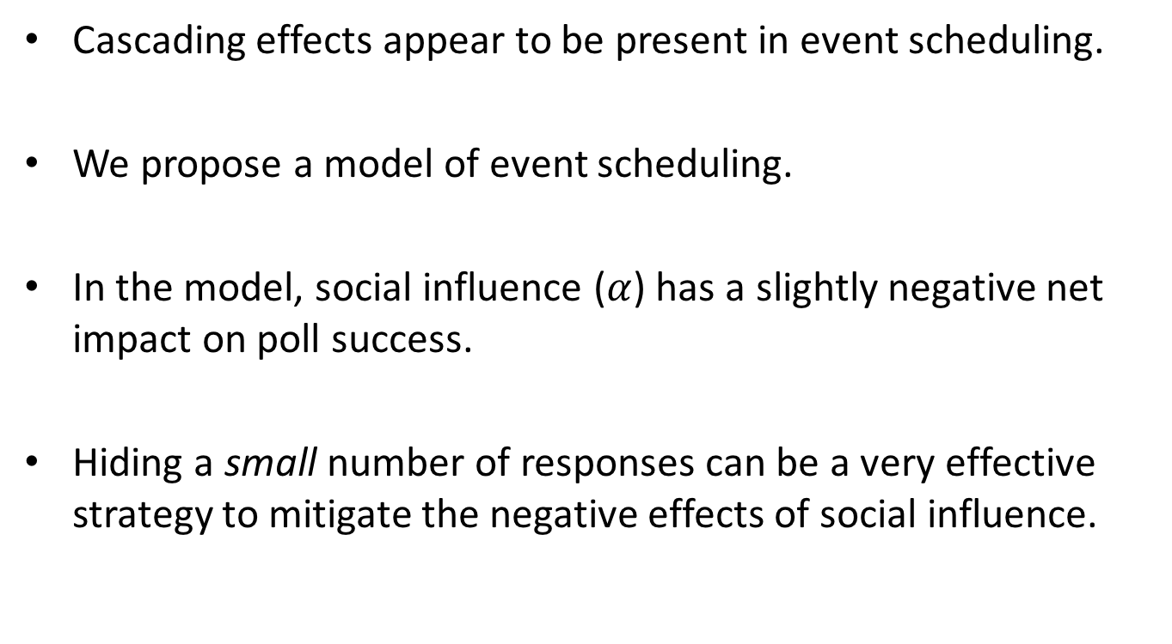
Conclusion
Cascading effects appear to be present in event scheduling.
We propose a model of event scheduling.
In the model, social influence ($α$) has a slightly negative net impact on poll success.
Hiding a small number of responses can be a very effective strategy to mitigate the negative effects of social influence.

