Slide 1
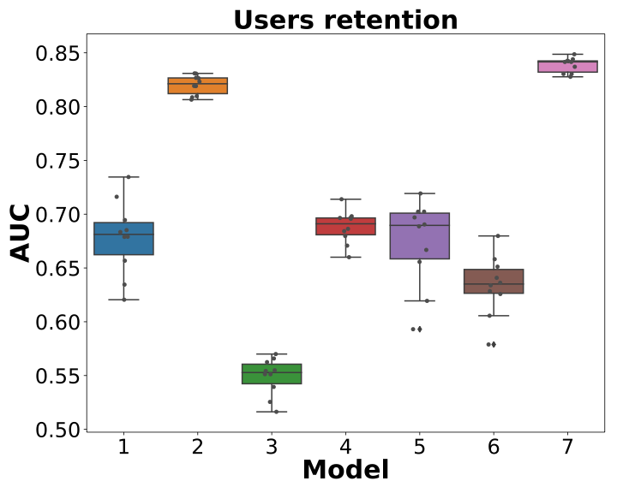
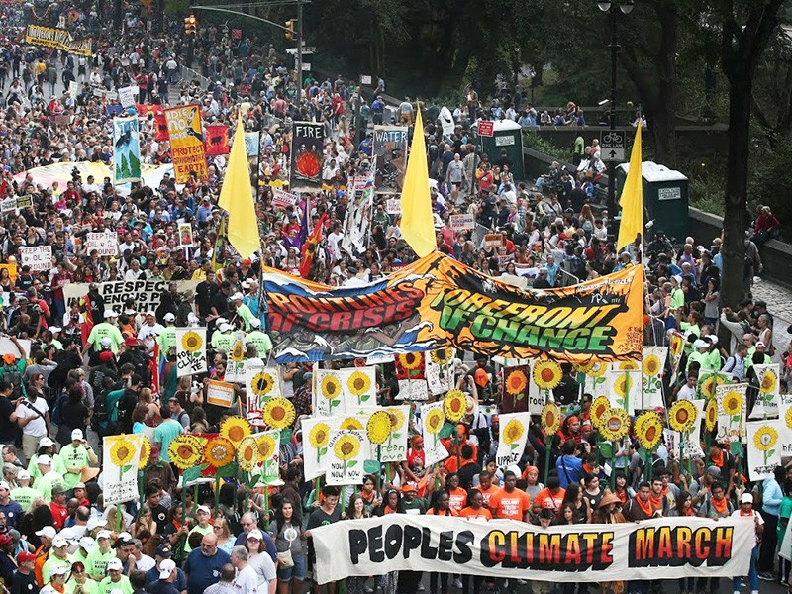
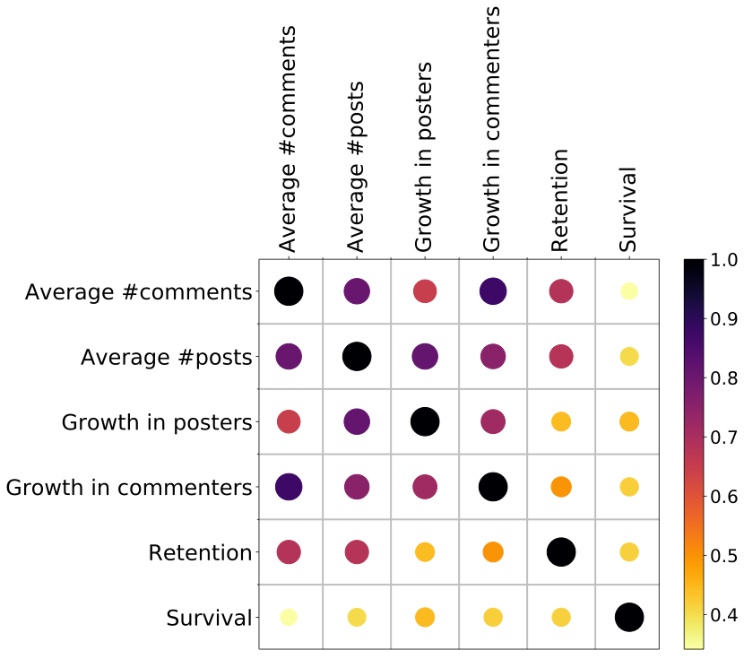
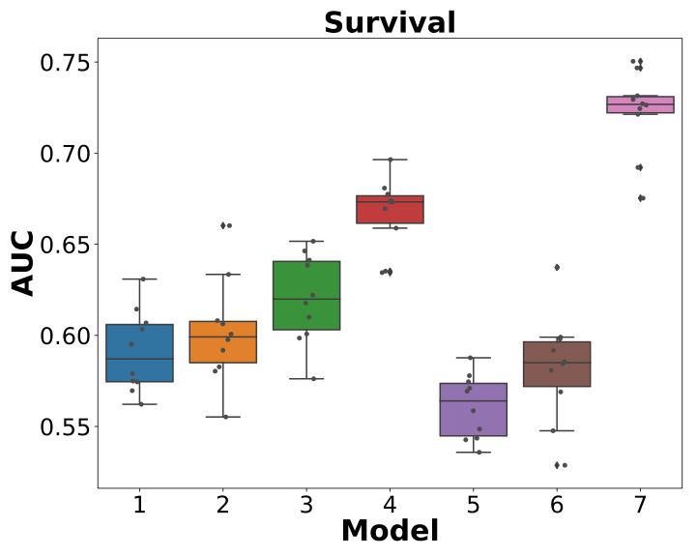
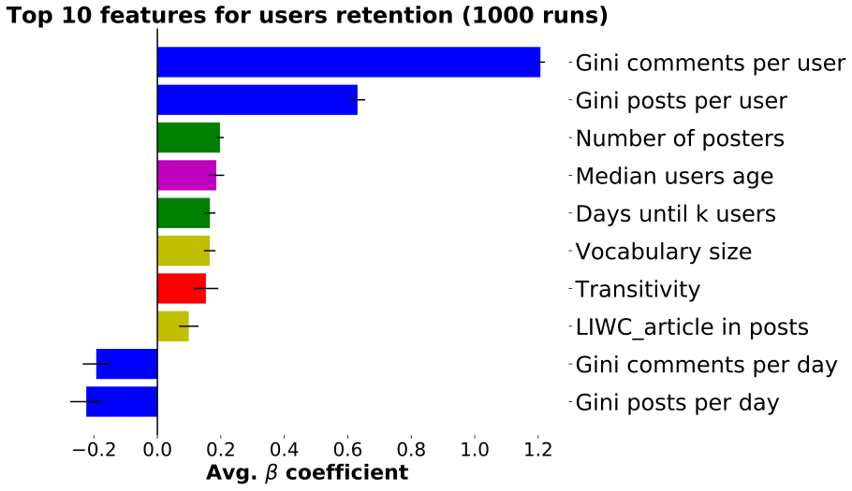
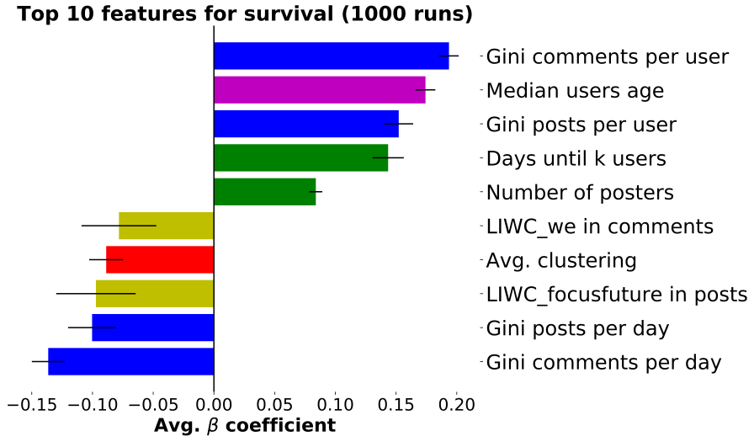
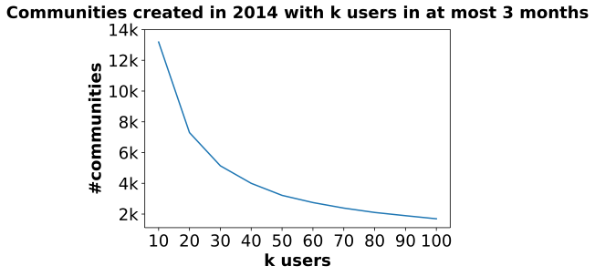
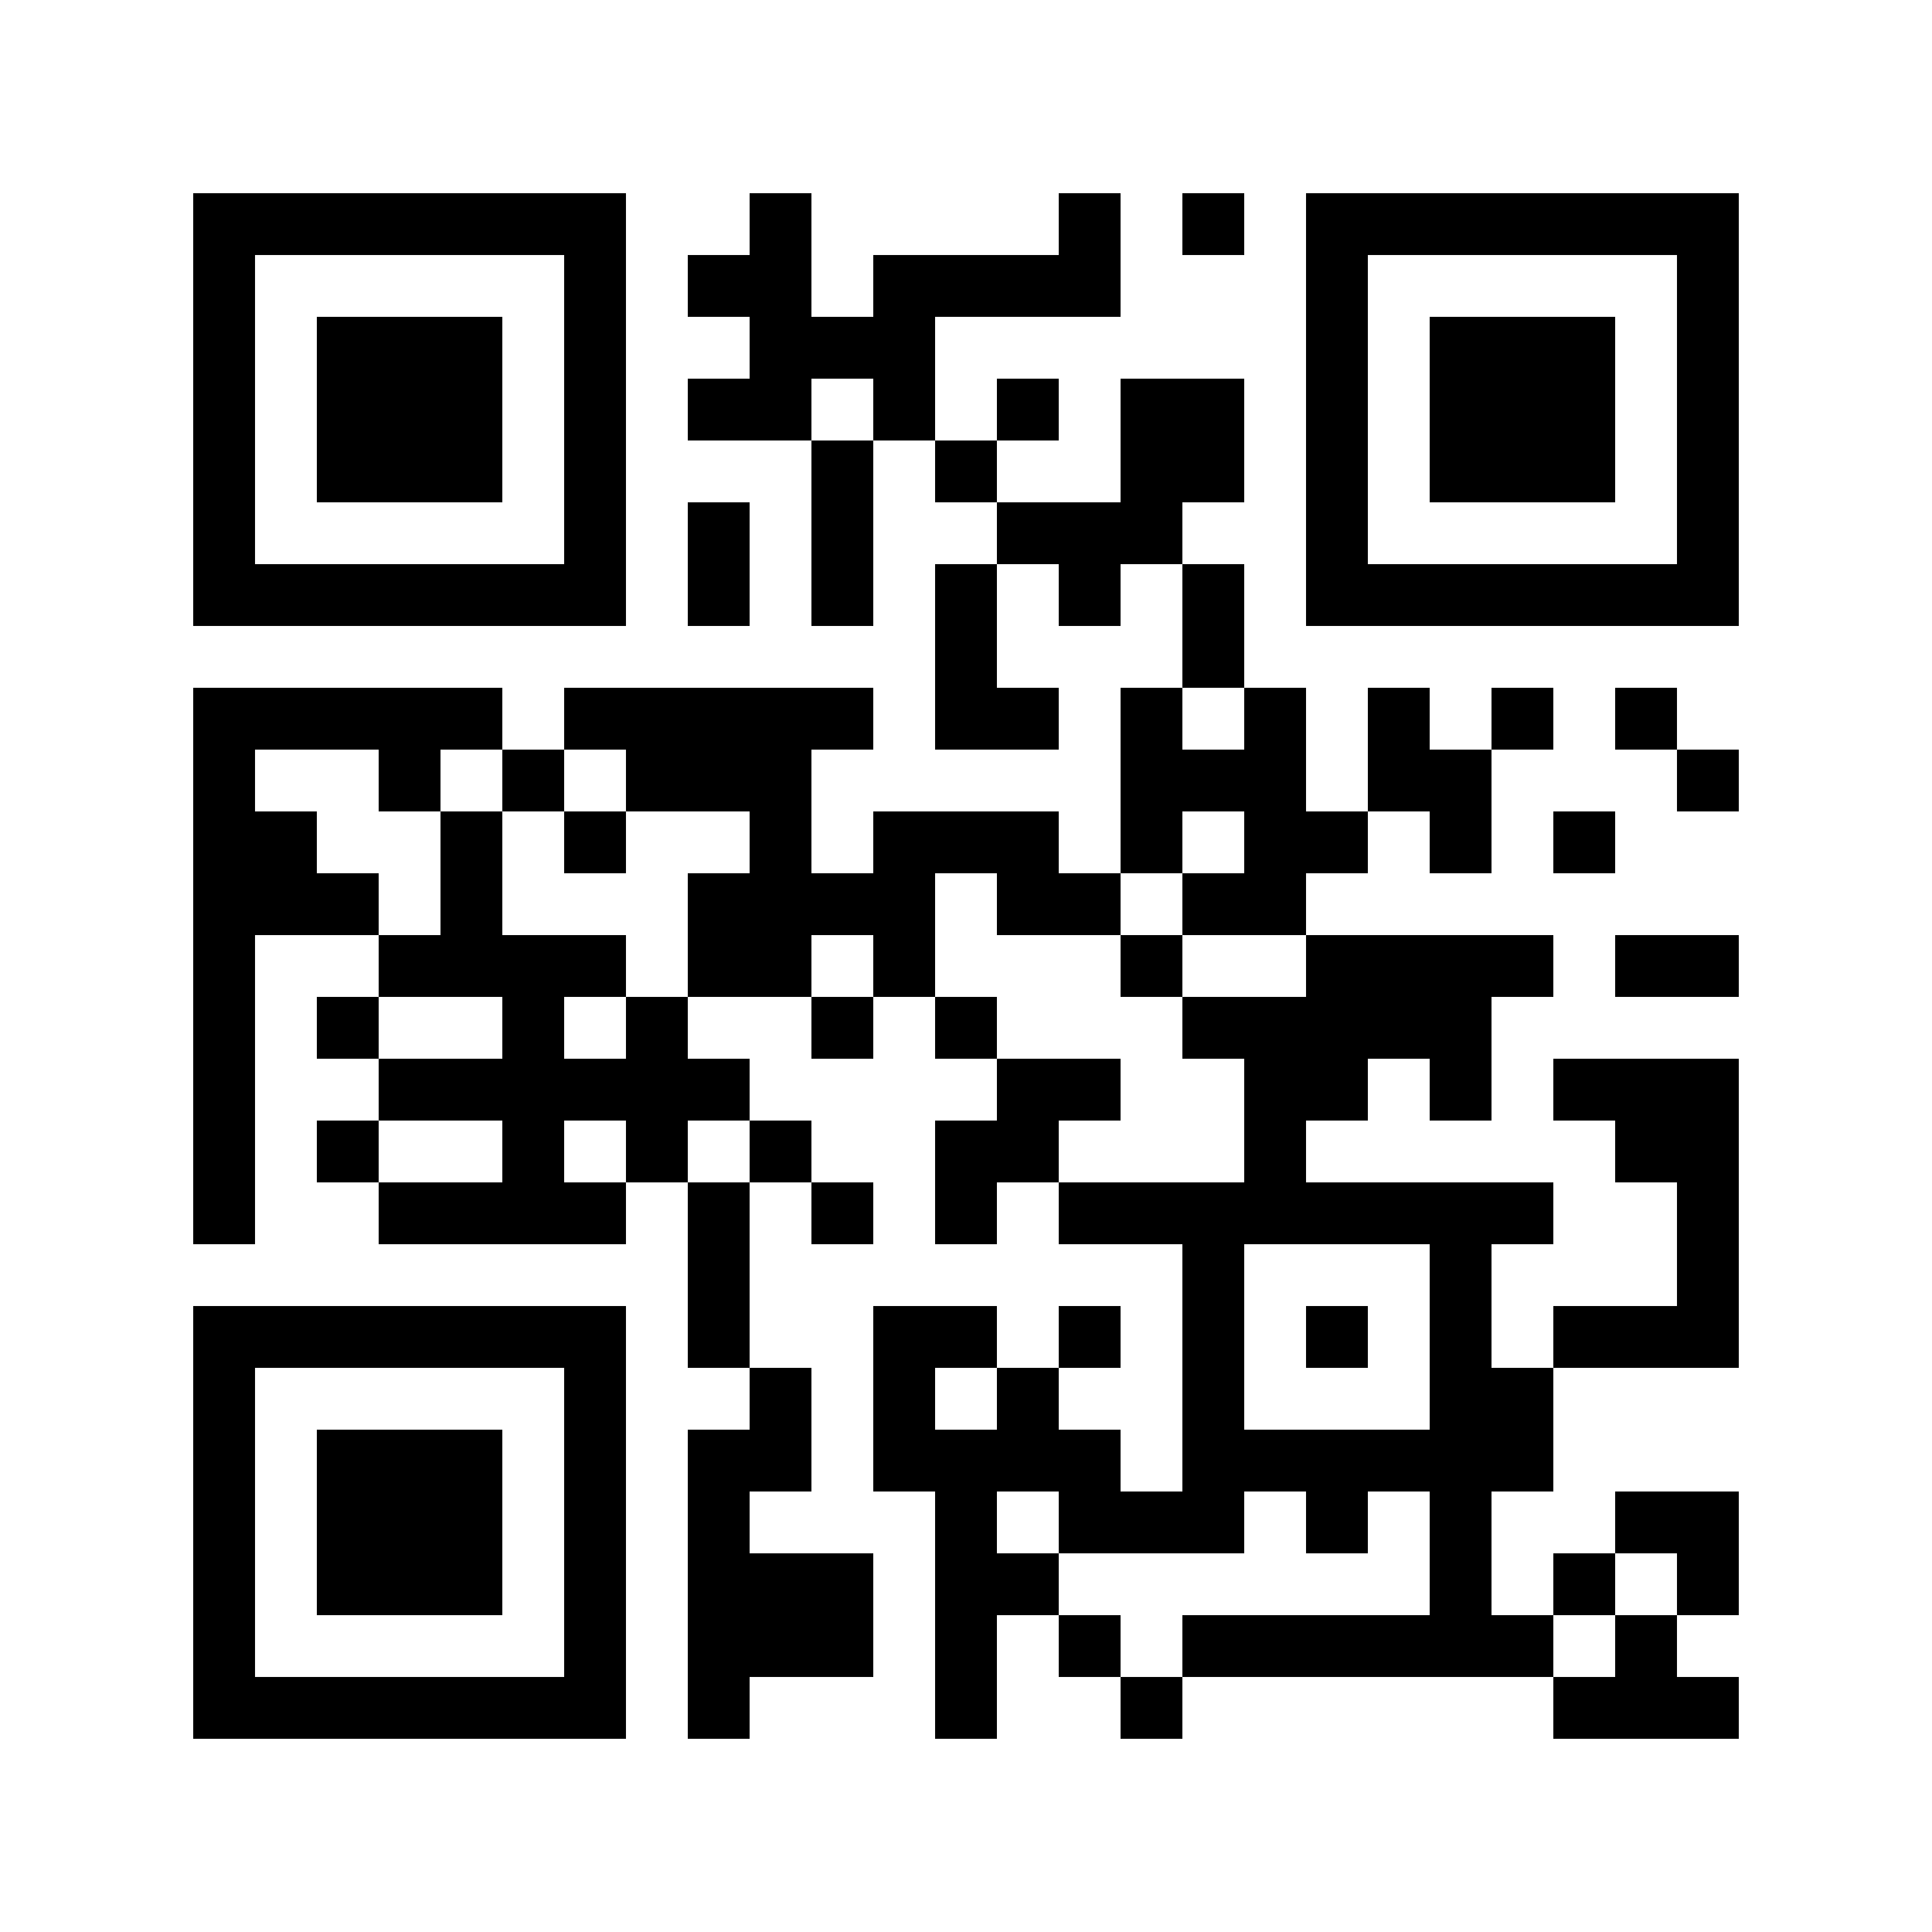
Are All Successful Communities Alike? Characterizing and
Predicting the Success of Online Communities
Tiago Cunha, David Jurgens, Chenhao Tan, Daniel M Romero
{tiolivei, jurgens, drom}@umich.edu, chenhao@chenhaot.com
Motivation
Relationship Between Success Measures
Results
Traditionally online group success is measured by the number of members.
We argue that considering a single measure of success has limited our understanding on what makes communities successful.
While all pairs of success measures have a positive correlation, many pairs have a relatively small correlations.
This suggests that different measures capture different aspects of being successful.
Our models perform well: AUC for retention is 0.84 and for survival is 0.72. A similar trend holds for other success measures.
The model combining all features performs better than the separate models, which suggest that no single model captures all aspects of community success.
For example, for user retention the best performing model is the distribution of activities and the worst is composition of users.
Diversely, for community survival the best single model is content features, followed by the composition of users.
Global warming awareness
Grad students
VS
Attracts a large number of members.
Small committed group.
High member retention.
Our Work
Has a broad view of success, exploring a variety of success measures of newly created communities on Reddit.
Measures future success along 6 dimensions:
Survival: if the community will be active after 2 years.
Retention: the average monthly user retention.
Growth in commenters: the number of new users commenting.
Growth in posters: the number of new users posting.
Average #comments: the average monthly #comments.
Average #posts: the average monthly #posts.
Investigates how the different success measures relate to each other.
Proposes a framework to investigate success along each individual dimension.
Explores which individual features predict success along each dimension.
Which Features Predict Success?
Having a small group of committed users who generate enough content until the community become self-sustaining is positively associated with all success measures.
Taking more time to reach k users, giving them time to interact and bond, is positively associated with survival and user retention (but negatively for other types of success).
There is a negative association between the use of pronoun "we" and the community’s long term survival.
Pairwise Spearman’s correlations among the set of success measures
Predicting Future Success
Task: The prediction for each success measure is framed as a binary task to predict whether that measure for a community will exceed the median value of that measure for all communities considered.
Dependent variables: Each one of the 6 success dimensions.
Independent variables: Inspired by prior work and theory, we consider six different categories of features to predict success.
Model: We train separate logistic regression classifiers for each feature category as well as a single model with the combination of all features.
Dataset
All posts and comments from subreddits created in 2014.
Focus on early community members:
…
Posts/comments sequence
1st user
2nd user
k-th user
Dependent variables
In at most 3 months.
K varying from 10 to 100.
Volume/speed of activities
Content features
Distribution of activities
Takeaways
Parent communities
Social features
Composition of users
Groups can succeed in different ways, in part due to the diversity of why a group forms. Success of a group is dependent in part on cultivating the types of behaviors needed.
Long term success can be predicted by early community behavior.
Different success measures can be predicted by different features (e.g content predicts survival, but not retention).
A small group of highly committed participants early on is key for all success measures.
Logistic Regression Classifier
Will it exceed the median?
More in our paper:

